Slide 1

Sukalpa tech
Commercial Vehicle Capabilities

Slide 2

Services for Commercial vehicles
Design Related
Research & Feasibility Study
Concepts Development
Product Design & Development
Prototyping
CAE Analysis & Simulation
Testing & Validation
Tooling, Jigs & Fixture Design
Value Engineering
Manufacturing Related
Plant Layout Design
Process Improvements
Process Documentation
Cost Saving Projects
Production Process Design
Equipment & Tools Selection
Homologation & Other
CMVR Type Approval
Sourcing & Vendor Development
FAME-II Certification
WMI Registration
Plant Accreditation
Training & Development
Staffing Solution

Slide 3
Design capabilities for Electric Bus
Bus Body Design & Development
- Styling (Interior & Exterior)
- BIW Structure
- Panelling
- Trimming
- Painting Scheme
- Component Design
- Testing & Validation
- Competitor Benchmarking
- CAE Analysis
Chassis, Electric Powertrain Design & Development
- Vehicle Specification
- Vehicle Architecture
- Electrical & Electronics Architecture
- System Sizing & Integration
- Chassis Design
- System Validation
- Thermal Management
- Wiring Harness

Slide 4
Manufacturing capabilities
Process Engineering
- Production Process Planning
- Layout Planning
- Facility Planning
- Production Capacity Planning
Industrial Engineering
- Continuous Improvements
- Time Study & Line Balancing
- Manpower Planning
- Work Instructions Documentation
- Material Flow
Tools & Fixtures
- BIW Fixture Design & Development
- Assembly Line Tools & Templates
- Machinery Planning
- Panelling & Trimming Fixtures
- Inspection Tools & Gauges
- Trolley Design & Development
-

Slide 5
Bus applications served
City Bus
Coach Bus
Sleeper Bus
School Bus
Articulated Bus
Ambulance
Types of Buses

Slide 6

Product development process
Product Strategy & Planning
Concept Evaluation & Development
Product Design & Development
Design Verification & Validation
Product Testing & Certification

Slide 7
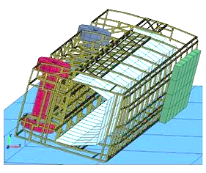
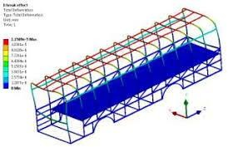
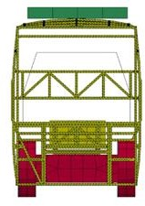
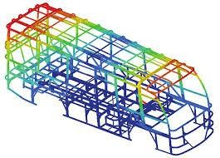
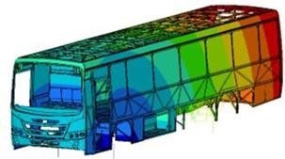
Design verification – simulation based
Strength Of Superstructure of Bus, Rollover Test (AIS :031)
Bus Stability Test (AIS:052)
Side Under - Run Protection
Sleeper Coach Roller And Berth Strength (AIS:119)
Natural Frequency of Test structure of bus (AIS:153)
Design Verification as per MoUD Specification (UBS-II)
Rollover Evaluation
Strength Evaluation
Durability Analysis
Stability Test
Vibration Analysis

Slide 8
Homologation process
Documentation Process
Vehicle Data Table Preparation
Communication with Testing Agency
Certification Grant
Administrative Execution of the Approval Process

Slide 9
WMI Registration process
Documentation Process
Application Submission
Documents Verification By BSI
WMI Proposal
Registration with SAE, USA
Issue of WMI Code

Slide 10
BUS Body Builders Accreditation process
Documents Gathering
Application Submission
Documents Verification
Plant Visit By Testing Agency
Feedback & Corrective Actions
Issue of Accreditation Certificate

Slide 11









Pool of Experts from Bus Industry

Slide 12
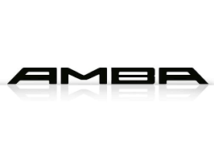



Customers served for BUS Segment
NAVABHARATH
Coach Builders

Slide 13
contact
Email : info@sukalpatech.com
Ph No : +91 78928 59968
Address : Sukalpa Tech, #1551, 6th Main, Annapoorneshwari Nagar,
Bengaluru – 560091
Website : www.sukalpatech.com

